Slide 1

Procurement in Focus – Navigating Legal Trends and Challenges
June 13, 2025

Slide 2
Land Acknowledgement
MLT Aikins acknowledges that our offices are located on the territories of the Indigenous peoples who have occupied these lands since time immemorial, including the First Nations of Treaty 1 (Winnipeg), Treaty 4 (Regina), Treaty 6 (Edmonton and Saskatoon), Treaty 7 (Calgary), the Coast Salish peoples (Vancouver), as well as other non-Treaty First Nations and Métis. We recognize that we benefit from the lands. We are dedicated to ensuring that the spirit of reconciliation is honoured and respected.

Slide 3

Today’s Presenter
Scott Masson Partner

Slide 4
Introduction
Projects have become more complicated and the market for contractors and vendors has become more competitive.
This requires purchasing organizations to re-think traditional procurement approaches.
Some of these changes include:
increased need to engage vendors early in the process;
evaluating proposals based on experience, qualifications or other non-price criteria;
evaluating different solutions from different vendors (e.g. difficulty comparing apples and apples); and
strategies to ensure competition in your procurement process as long as possible.

Slide 5
Key Industry Trends
1
Increased project size and complexity
2
Increased technology and innovation
3
Tariff uncertainty and resulting buy-Canadian initiatives
4
Expansion of “Prompt Payment” regimes across Canada
5
Changes in approach to contractual risk allocation
6
Growth of early contractor engagement and other collaborative delivery models

Slide 6
Planning Your Procurement Process
Use a flexible procurement process (RFP not a Tender)
Potential options include, but are not limited to:
Request for Strategic Partner (RFSP)
Request for Qualifications (RFQ)
Request for Information (RFI)
Request to Develop a Joint Solution
For public sector entities, ensure trade agreement compliance.

Slide 7
Qualifications Based Procurement
Qualifications Based Procurement is commonly used for procuring professional services (e.g. architecture, engineering etc.).
Under this approach, the procuring entity focuses more on qualifications rather than price.
Evaluation criteria often include:
Relevant experience;
Technical competence;
Team qualifications;
Past performance; and
Project understanding.

Slide 8
Procurement Considerations
The nature of a Qualifications Based Procurement means the client is often making a selection based on the qualifications and experience of the proponents.
The challenge for the client is preserving competition in the procurement process.
This can be accomplished in a number of different ways:
Best and Final Offer process;
Concurrent negotiations; and
Consecutive negotiations.

Slide 9
Defining The Project
What is the scope of the project?
What is the business/technical/operations problem the client is trying to resolve?
How will the proposed solutions fit into the client’s current systems?
Is there a specific innovation or technology that the client is looking for?

Slide 10
Market Engagement
Early market engagement can be a key to success in designing a successful procurement.
Market engagement can help ensure a fit between the requirements of the project and current market capabilities.
Allows the client to understand different approaches to similar projects.
Ensures competition during the procurement process – is the market willing to supply what the client is looking for.
Helps to refine the client’s project definition as well as defining realistic evaluation criteria. It also helps to identify key project risks.

Slide 11
Addressing Tariff Risks in Your Procurement
Do different proponents and suppliers have different supply chain risks?
Are there concerns with vendor solvency in a challenging economic environment?
As an owner or buyer, can advance purchase or free-issue supply be utilized from non-US sources of supply?
For public sector organizations, do announcements by provincial or federal governments on purchasing from US-based suppliers apply?
Will potential changes to exceptions in the Canadian Free Trade Agreement shift sources of supply or lead to more robust open procurement requirements?

Slide 12
Early Contractor Involvement
Early Contractor Involvement (ECI) allows a builder to become involved, and potentially start work, before the design has been completed.
ECI can be integrated into a traditional construction management model. The concept can also be applied beyond construction.
ECI allows the construction manager to provide insight during the design process into:
Cost
Schedule
Constructability
Phasing
Material selection
They may also be able to provide information based on its own experiences and supply chain.

Slide 13





Meet the rest of our team
Danielle Graff Partner
Charlene Lipchen Counsel
Stephanie Symonds-D’Arcey Associate
Natasha Hepp Associate
Braden Nehring Associate

Slide 14

Western Canada’s Law Firm
MLT Aikins is a western Canadian law firm, distinguished by full-service capabilities and a national reputation for excellence.
Strategically positioned in six major centres across four provinces, we operate as one cohesive team. Our unified approach allows us to offer comprehensive services across all practice areas. Our firm combines deep regional knowledge with a broad reach across Canada.

Slide 15
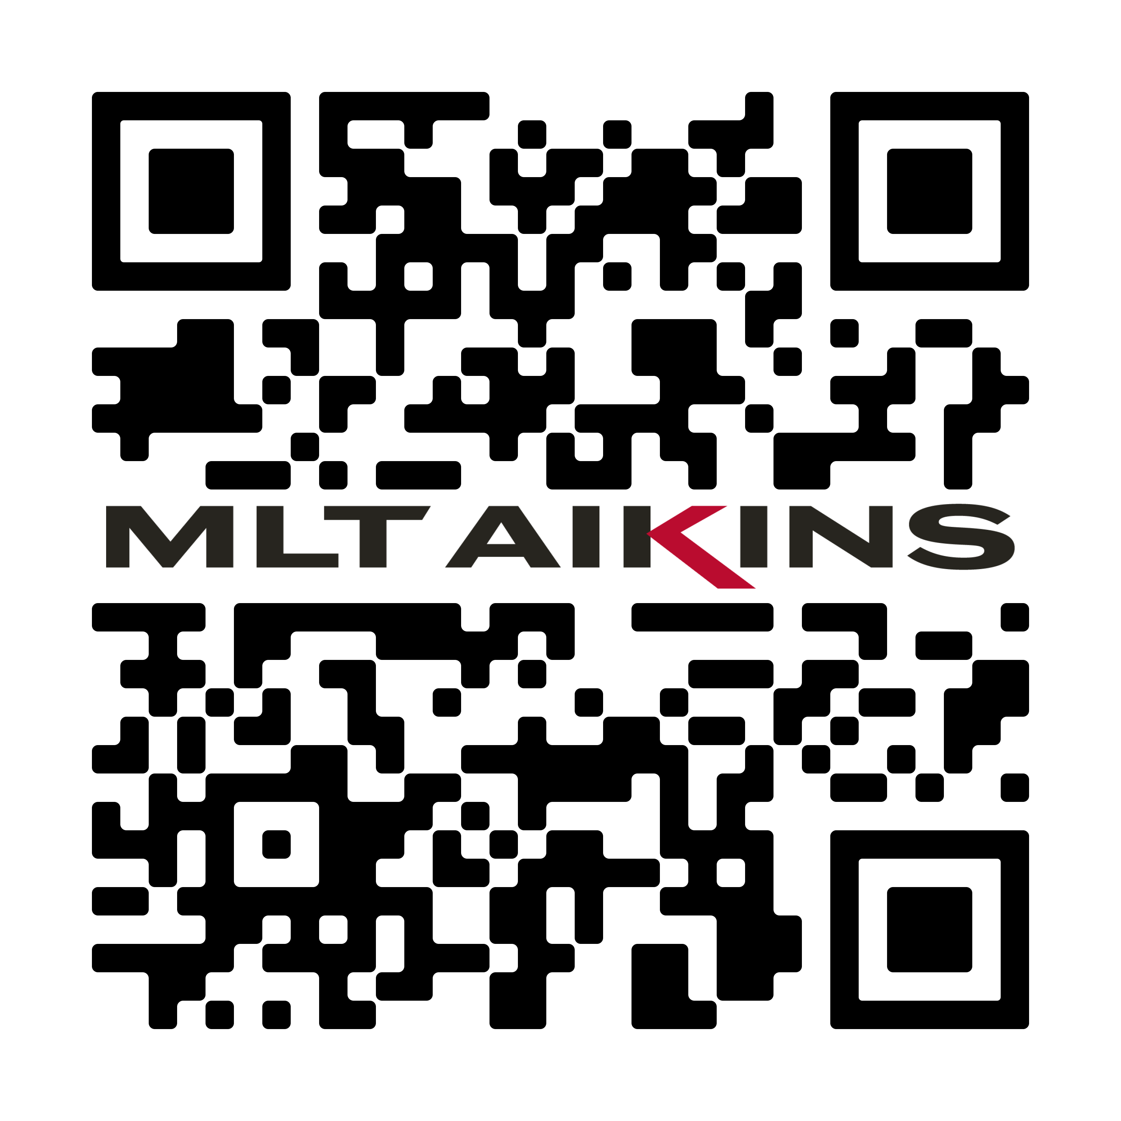
Thank you
Scott Masson
(306) 956 – 2160 smasson@mltaikins.com
“MLT Aikins,” the MLT Aikins Designs and “Western Canada’s Law Firm” are trademarks of MLT Aikins LLP. Copyright © 2025 MLT Aikins LLP. All rights reserved.
Note: This presentation is of a general nature only and is not exhaustive of all possible legal rights or remedies. In addition, laws may change over time and should be interpreted only in the context of particular circumstances such that these materials are not intended to be relied upon or taken as legal advice or opinion. Readers/viewers should consult a legal professional for specific advice in any particular situation.

